Slide 1
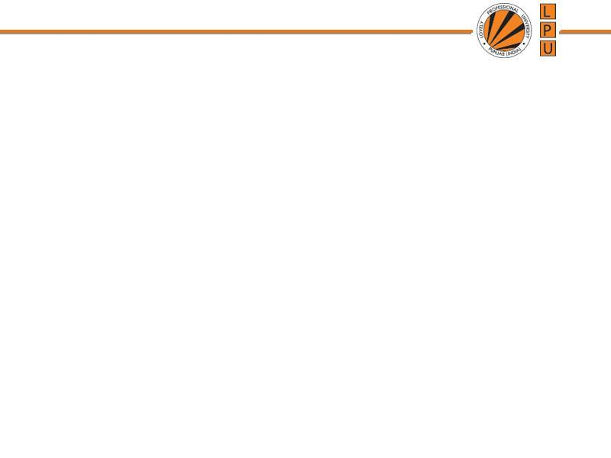
Chapter: Memory Management

Slide 2
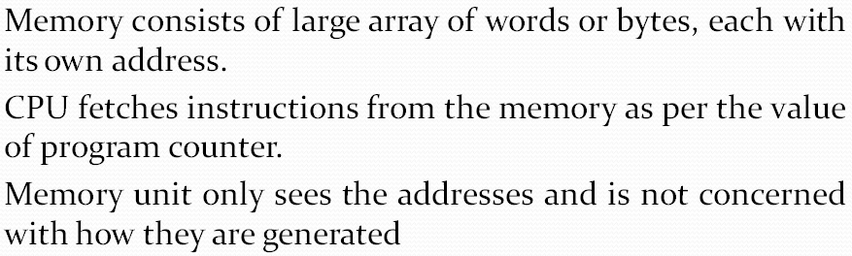
Memory

Slide 3
Memory
Computer has 2 types of memory:
Main Memory: temporarily stores data and instructions executed by the computer. CPU retrieve instructions from main memory and executes it.
Secondary Memory: directly is not accessed by CPU. It is an external storage.

Slide 4
Address Binding
Address Binding: Assigning an address to data or instruction.
Address binding is a process of generating address where the data/instruction is to be stored in memory.
3 types of address binding:
Compile time binding
Load time binding
Run time binding

Slide 5
Address Binding
Address Binding: Fixing a physical address to the logical address of a process address space
Compile time binding: it is known to compiler at compile time where a program will reside in physical memory (Main Mem.)
Load time binding: if program location in memory is unknown until run-time.
Execution/Run time binding: If the process can be moved during its execution from one memory segment to another, then binding must be delayed until run time. The absolute addresses are generated by hardware.

Slide 6
Address Space of process
Make sure that each process has a separate memory space.
Separate per-process memory space protects the processes from each other.
To separate memory spaces, we need the ability to determine the range of legal addresses that the process may access and to ensure that the process can access only these legal addresses.

Slide 7
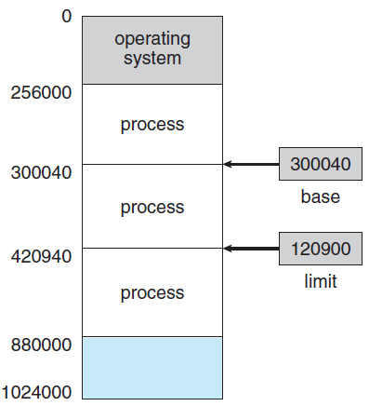
Address Space of process
We can provide this protection
by using two registers, usually a base and a limit
Base register holds the smallest legal physical memory address
Limit register specifies the size of the range.
e.g. For example, if the base register holds 300040 and the limit register is 120900, then the program can legally access all addresses from 300040 through 420939 (inclusive)

Slide 8
Protection
Protection of memory space is accomplished by having the CPU hardware compare every address generated in user mode with the registers.
Any attempt by a program executing in user mode to access operating-system memory or other users’ memory results in a trap to the operating system

Slide 9
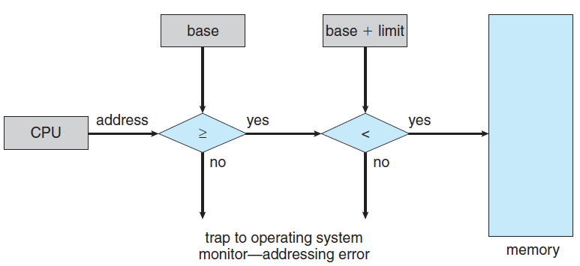
Protection
Base register and limit registers can only be updated by OS in kernel mode.

Slide 10
Logical and Physical Address Space
1. Logical Address or Virtual address:
a. The address generated by CPU.
b. Logical address is address of instruction / data as used by program at some time.
Set of all logical address generated by program is Logical address space

Slide 11
Logical and Physical Address Space
Physical Address:
It is the address used seen by memory management unit (MMU).
It refers to actual location in the main memory.
The user can never view physical address of program
Set of all logical address that a process actually occupies is Physical address space
The logical address is used like a reference, to access the physical address
MMU is used to map logical and physical addresses.

Slide 12
Logical and Physical Address Space
The run-time mapping from logical (virtual) to physical addresses is done by a hardware device called the memory-management unit (MMU).
The base register is now called a relocation register.
The value in the relocation register is added to every address generated by a user process at the time the address is sent to memory.

Slide 13
Logical and Physical Address Space
Assume logical addresses (in the range 0 to max) and physical addresses.
For User program CPU generates only logical addresses and thinks that the process runs in locations 0 to max.
These logical addresses must be mapped to physical addresses before they are used by MMU

Slide 14
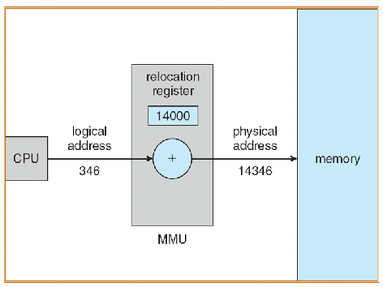
Logical and Physical Address Space

Slide 15
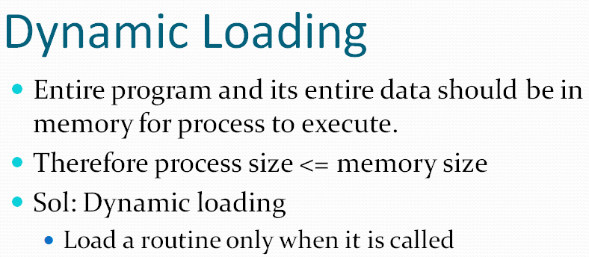

Slide 16
Swapping
Technique of removing a process from main memory and storing it into secondary memory, then bringing it back into main memory for continued execution.
It is a technique used in multiprogramming environments which have limited memory capacity.
Action of moving process out of main memory is called Swap Out
Action of moving process into main memory is called Swap In
Area on the disk where swapped out process are stored is known as Swap Space.

Slide 17
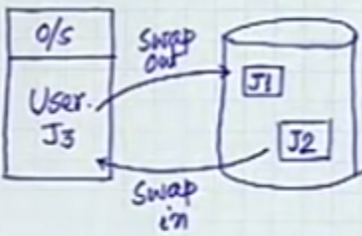
Swapping
During Swap-Out foll. Things are checked:
While in Main Memory was user program modified?
Yes: write it back to Sec. Memory
No: Sec. Memory already has a copy of it, no need to write.
Overwrite J3 with new program. I.e bring new program

Slide 18
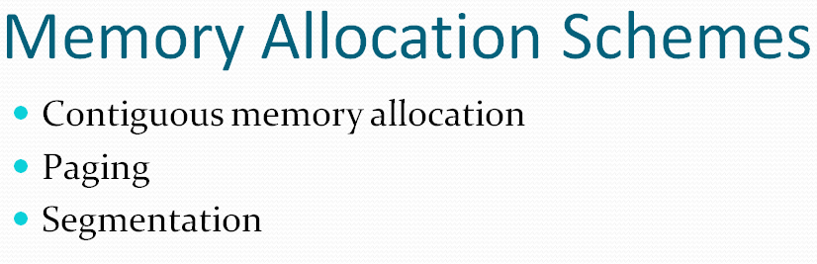

Slide 19
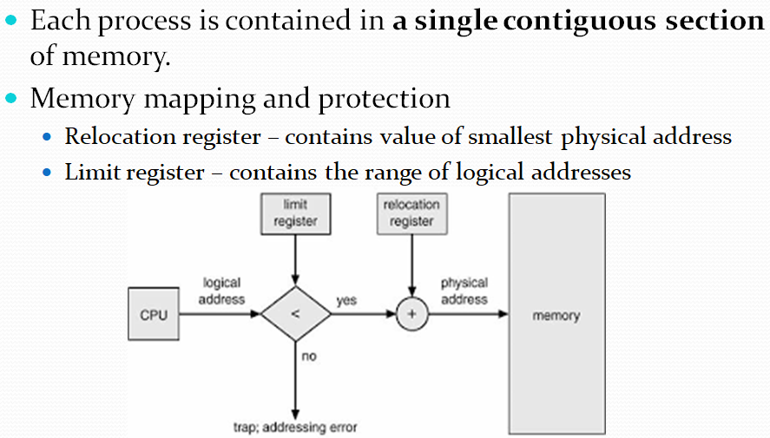
Contiguous File Allocation
Relocation Register contains base address of the process

Slide 20
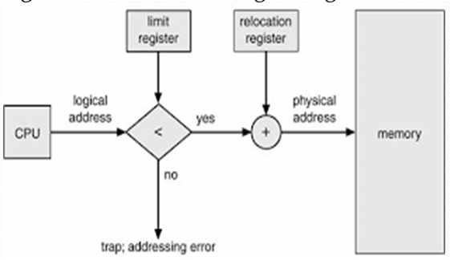
Contiguous File Allocation

Slide 21
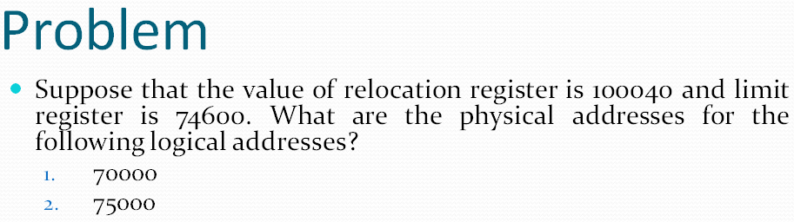
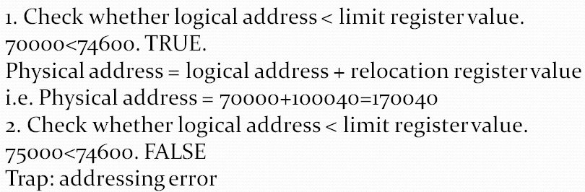

Slide 22
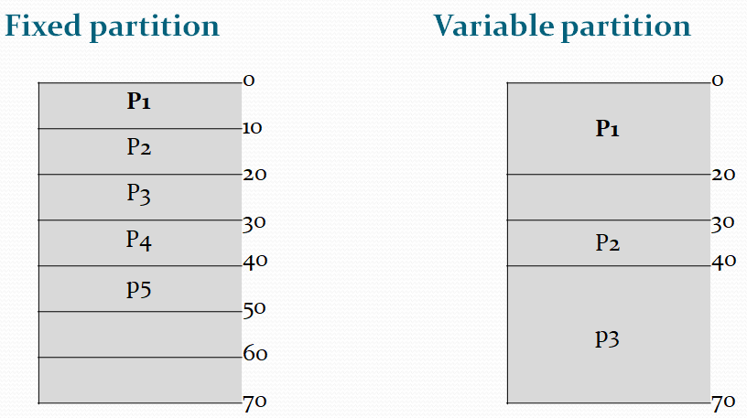
Partitions

Slide 23
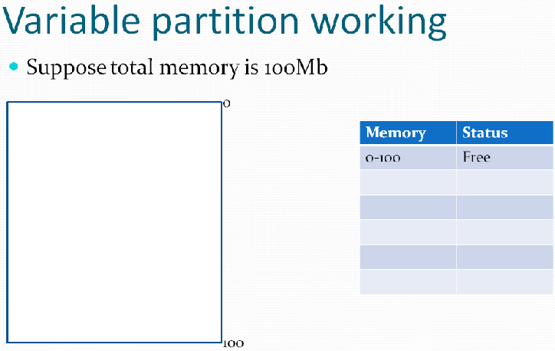
P1 needs 10mb space

Slide 24
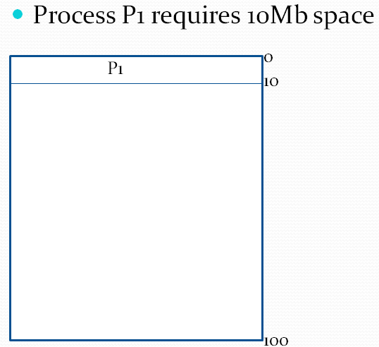
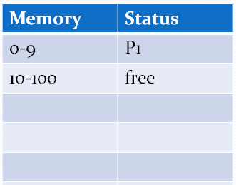

Slide 25
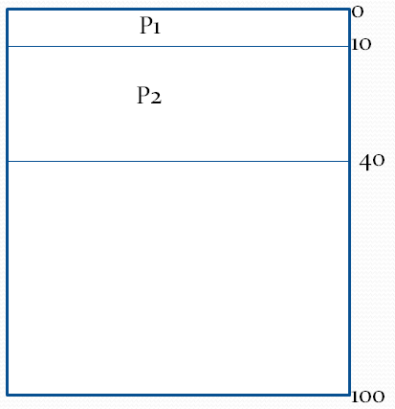
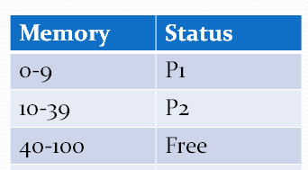
P2 needs 30mb space

Slide 26
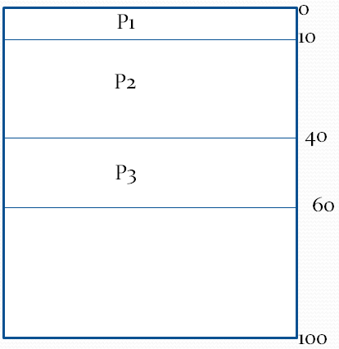
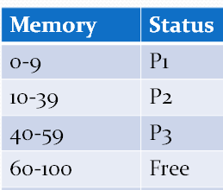
P3 needs 20mb space

Slide 27
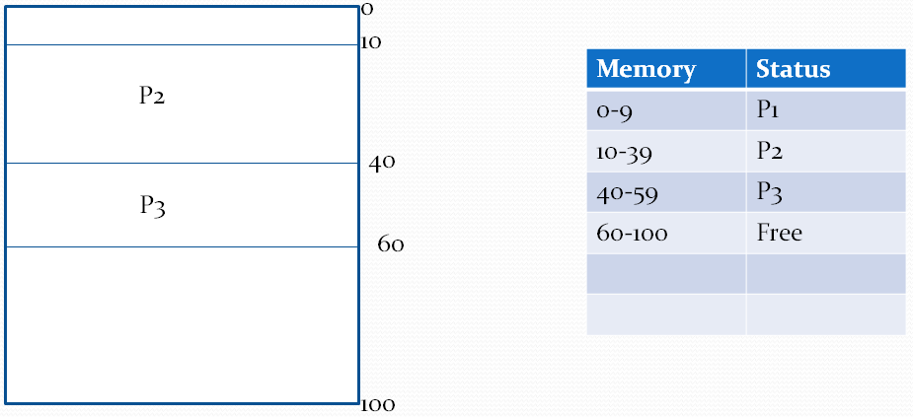
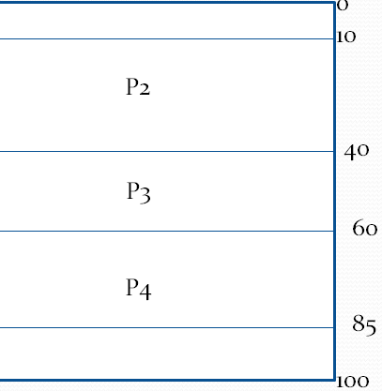
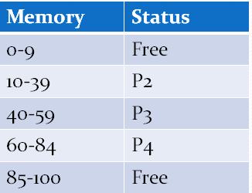
P1 finishes its execution
So space is free
P4 need 25mb
Free

Slide 28
P3 finishes its execution
So space is free
P5 need 25mb
Free
Free

Slide 29
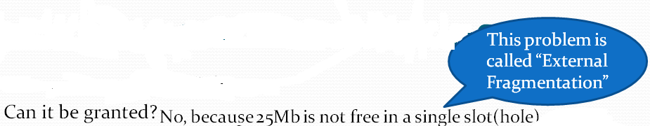
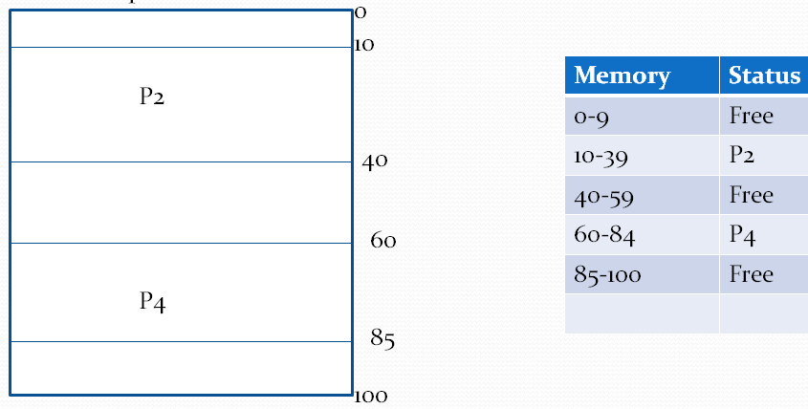
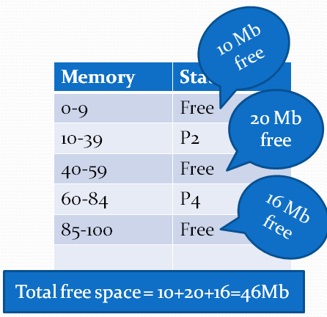
P3 finishes its execution
So space is free
P5 require 25Mb space

Slide 30
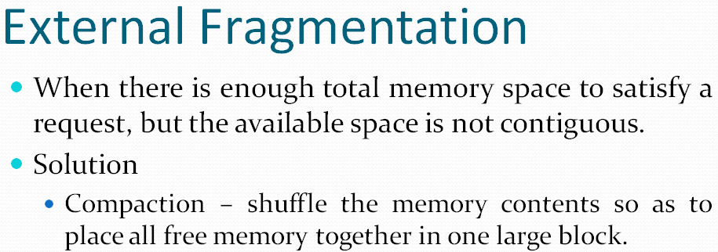

Slide 31
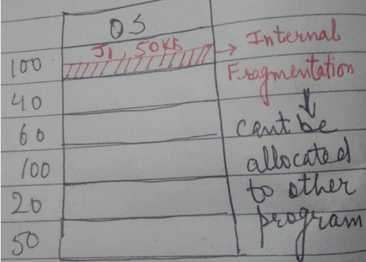
Partition Allocation
One method of allocating contiguous memory is to divide all available memory into equal sized partitions, and to assign each process to their own partition.
Partition Allocation Algorithms:
First Fit:
  Checks all partitions serially
  When partition with size = or > encounters, it is allocated for storage.

